Slide 2
Odisee in good company
A cooperative university of applied sciences in Belgium

Slide 3
Where is Odisee located?
1.
BELGIUM – FLANDERS – BRUSSELS

Slide 4

Belgium … … at the heart of the world
… at the heart of Europe

Slide 5
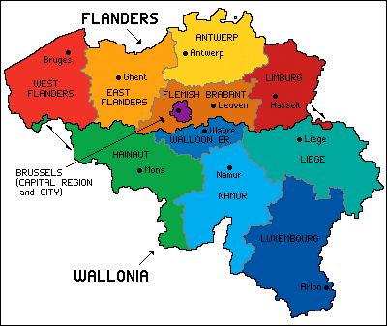
How Belgium is divided
How Belgium is governed
Flemish Region
Flemish speaking
Flemish
Community
Brussels Capital Region
Bilingual
French
Community
Walloon Region
French speaking
German
Community
German speaking

Slide 6
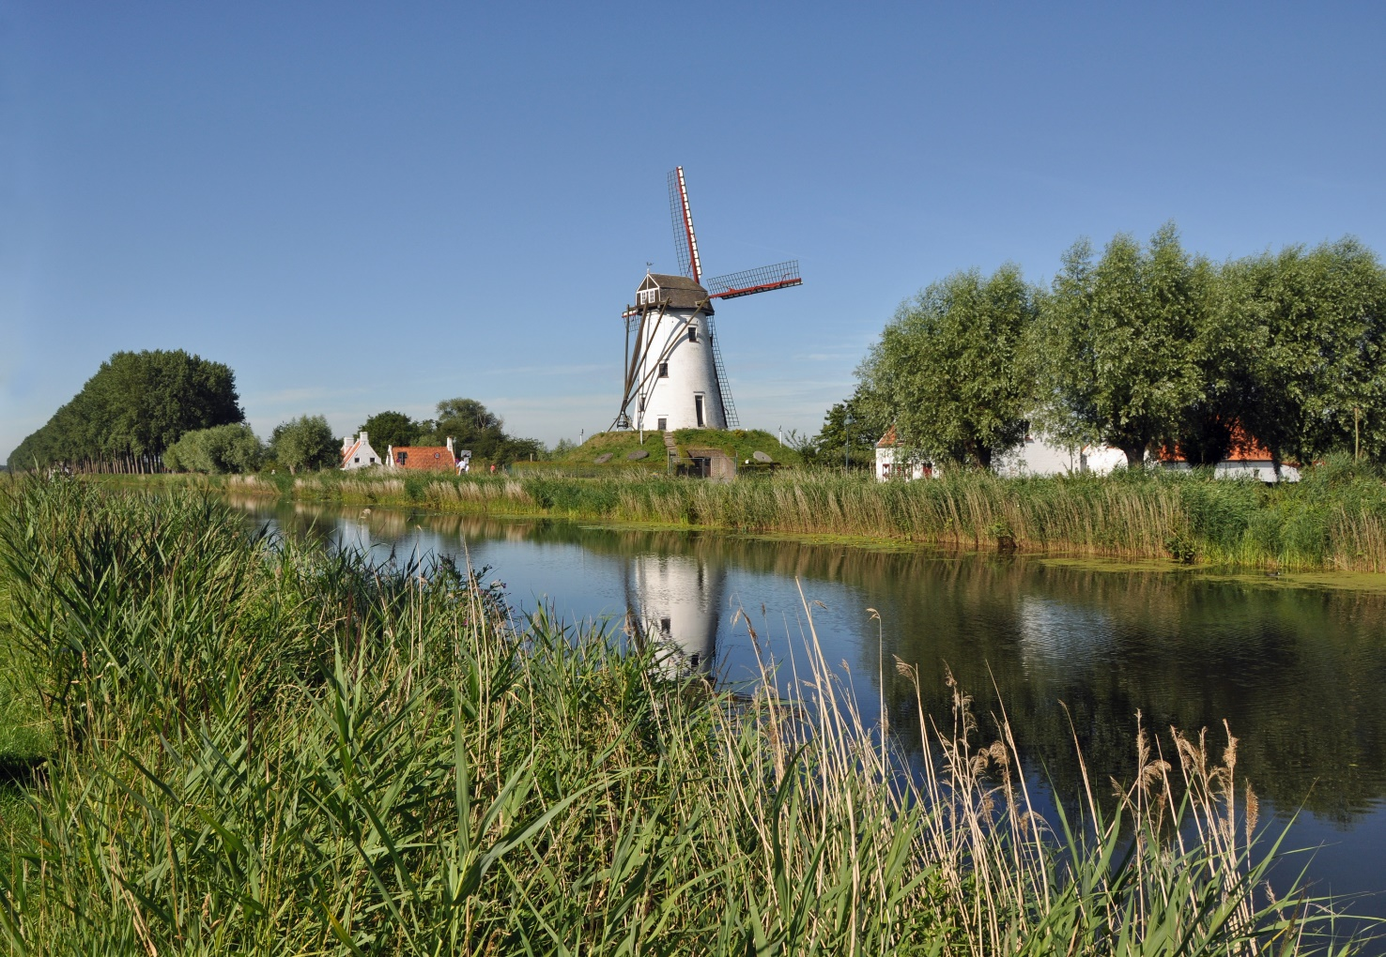
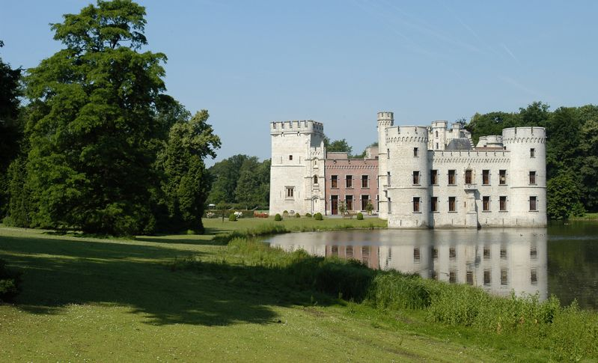
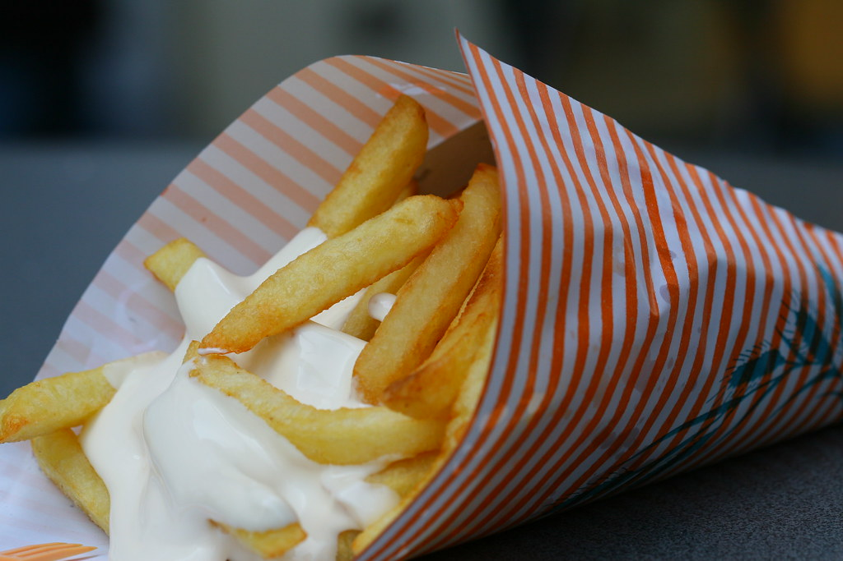
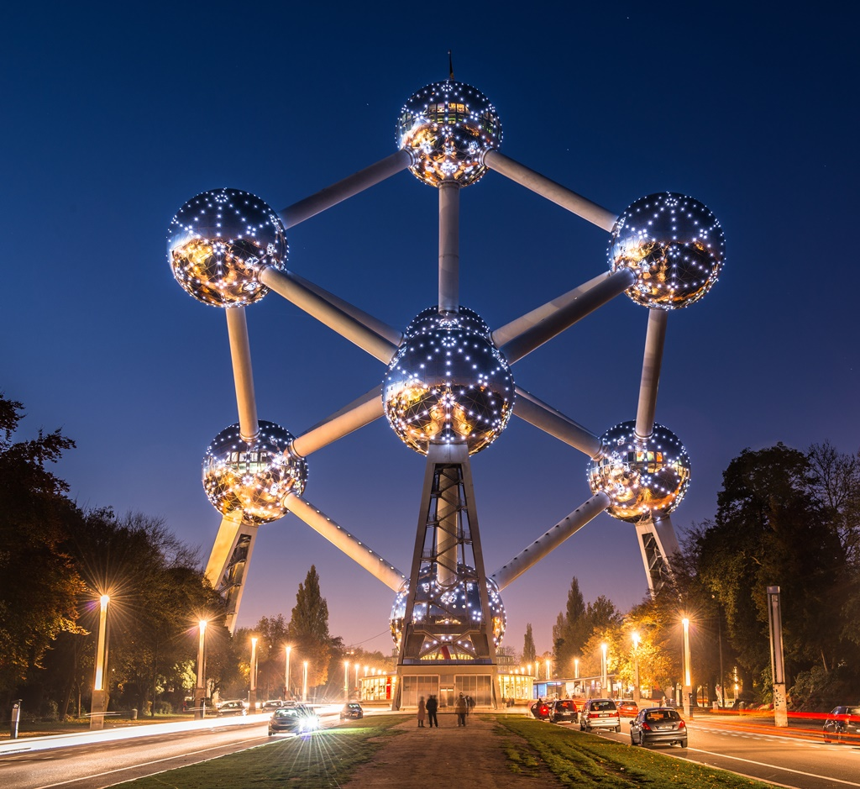
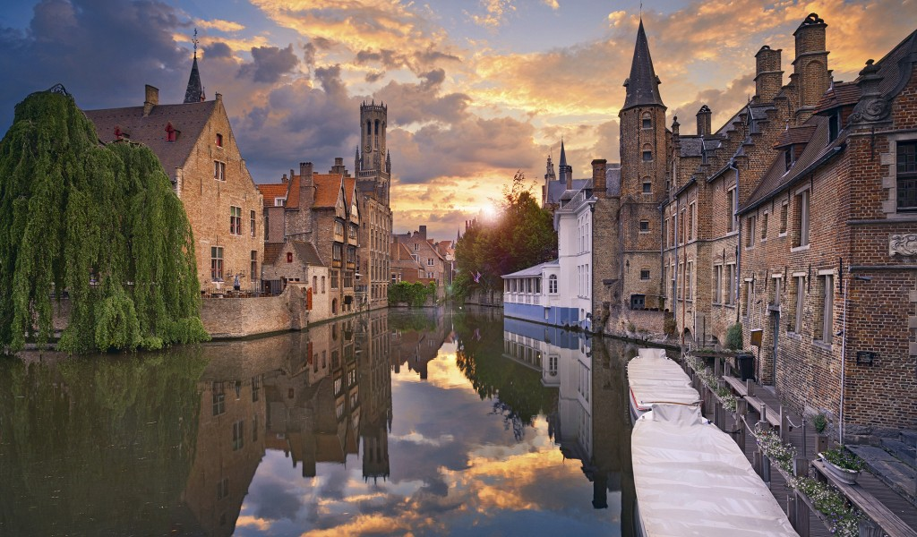

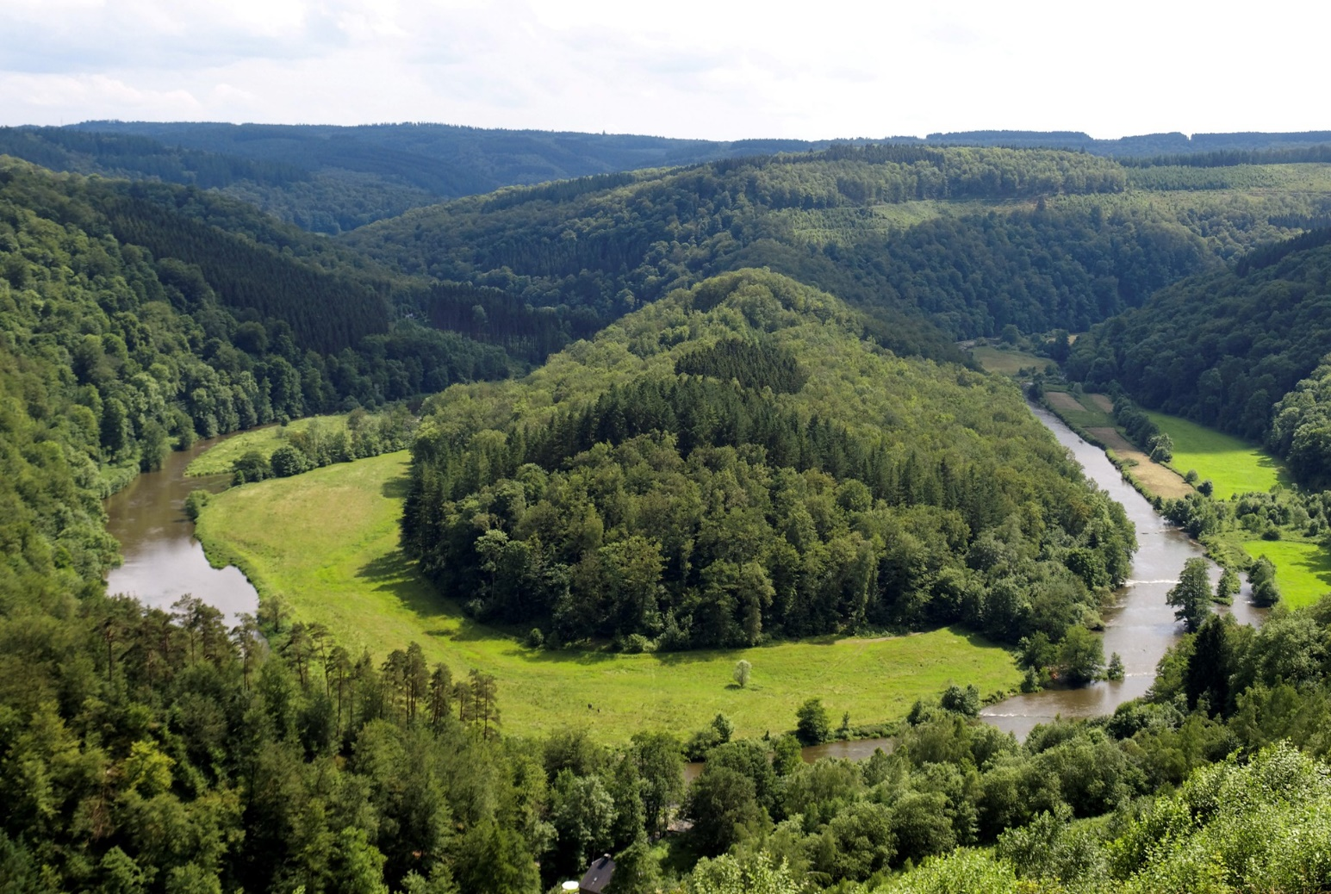

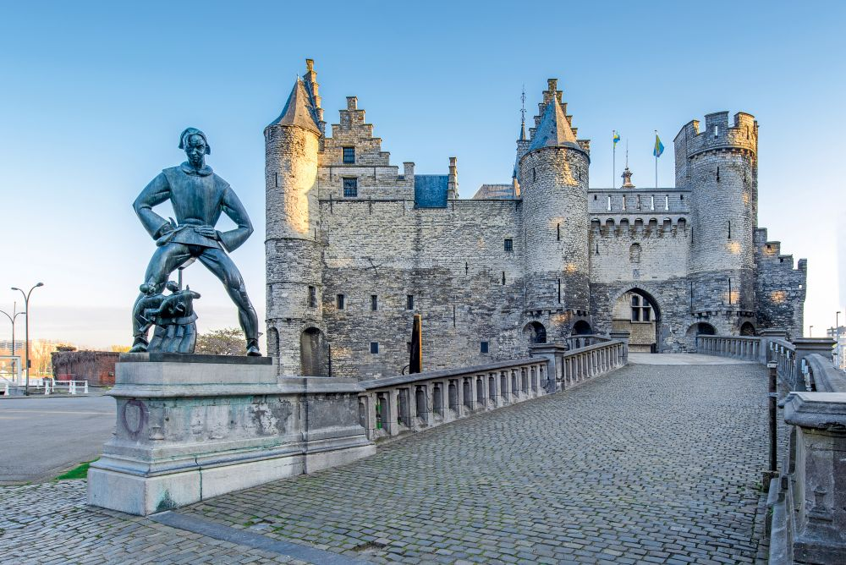
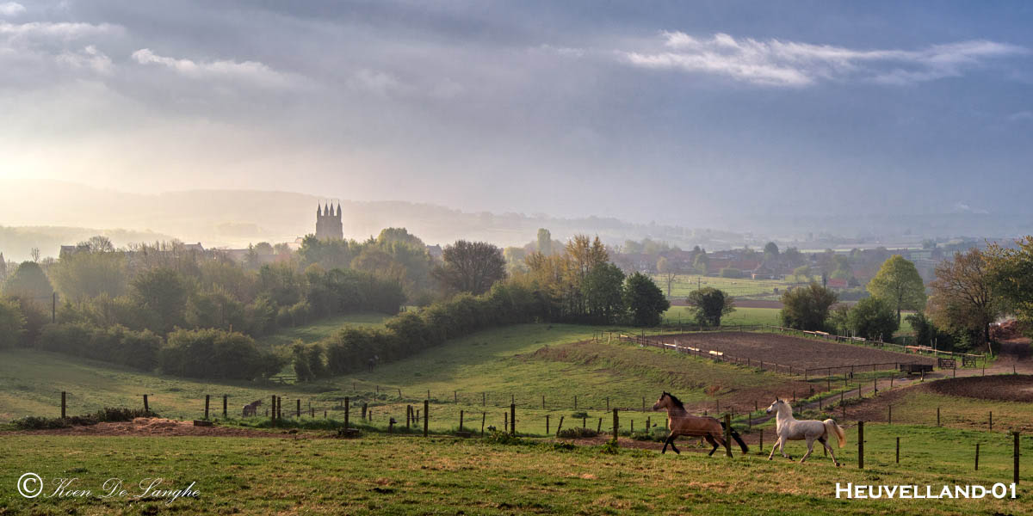

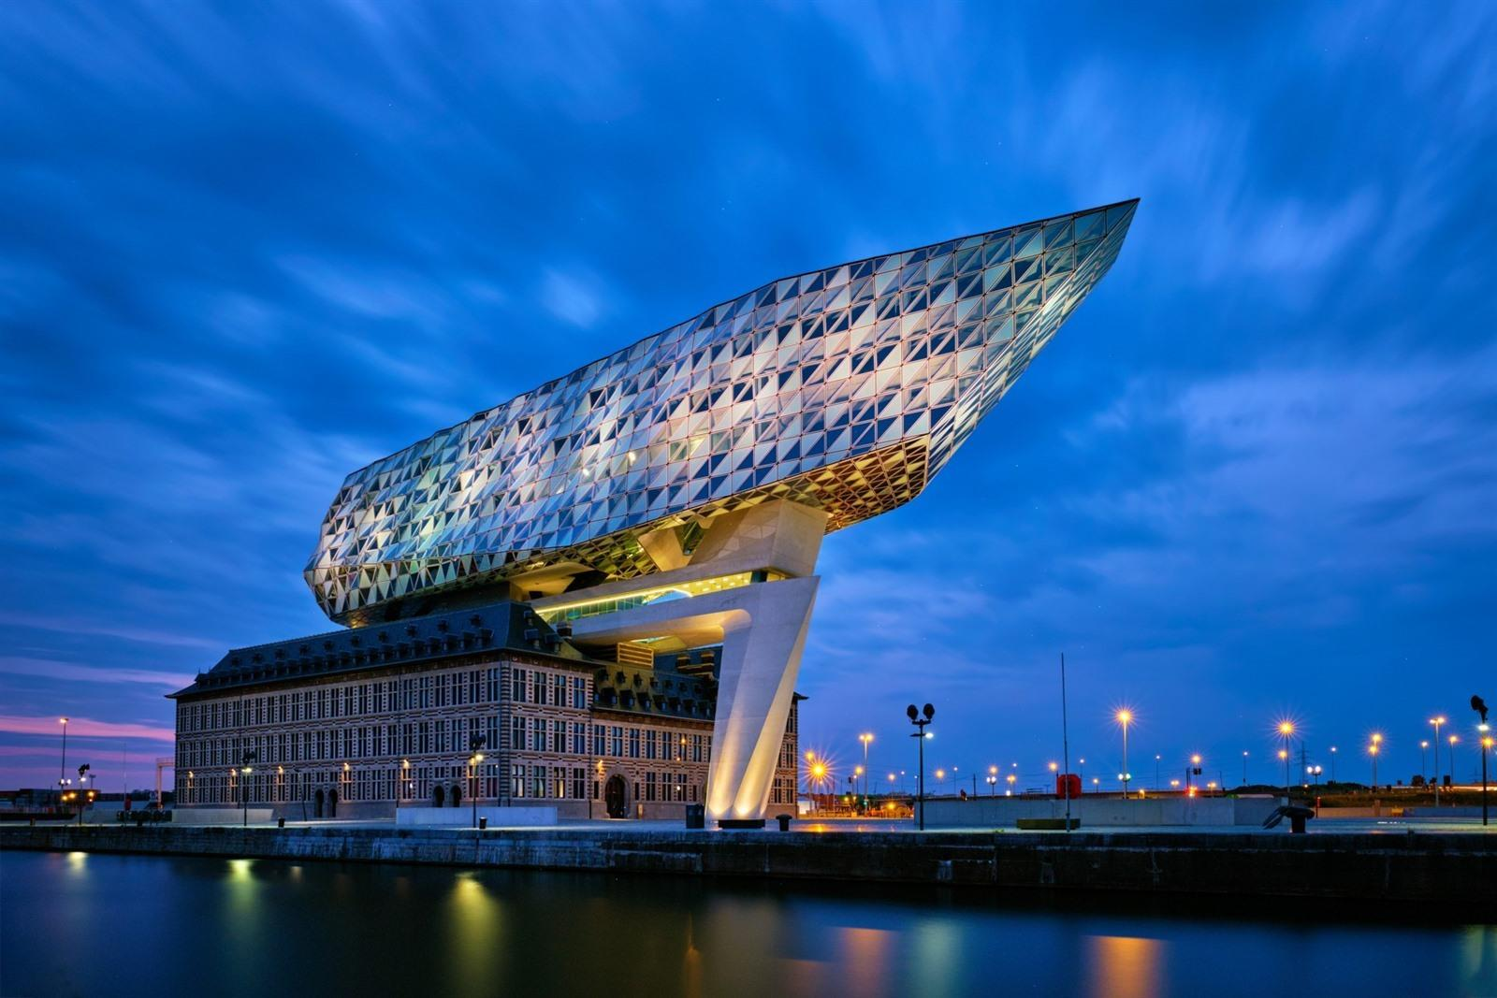
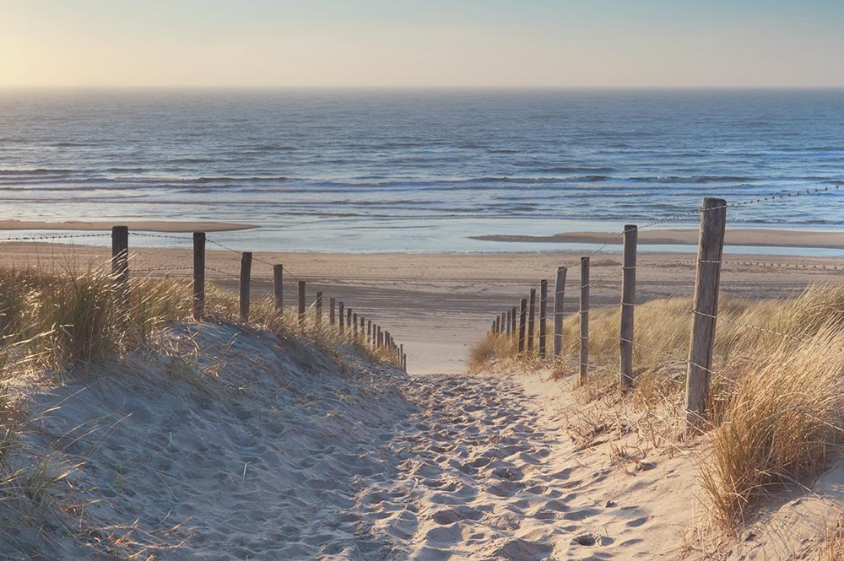
What Belgium is famous for
  Amazing gastronomy and also the best fries, chocolates and beers
  Astonishing Cultural Cities, such as Brussels, Bruges, Ghent, Antwerp…
  Green regions reaching from the coastline to the Ardennes and lots more in between
  And did we mention Belgian beers?

Slide 7
Facts on Belgium and Flanders
 | BELGIUM | FLANDERS
 |  | Northern part of Belgium
 |  | Federated entity of Belgium
Capital | Brussels (50°51′N 4°21′E)
Official languages | Dutch, French, German | Dutch
Government | Federal parliamentary | Regional parliamentary
 | constitutional monarchy
King | Philip I
Prime Minister | Alexander De Croo | Jan Jambon
Area | 30,528 km² [11,787 sq mi] | 13,522 km² (5,221 sq mi)
Population | 11,007,020 | 6,161,600
Density | 354.7 / km² [918.6/sq mi] | 456/km² (1,180/sq mi)
GDP (per capita) | $36,834 | $40,969
Currency | Euro (€) (EUR)
Time zone | CET (UTC+1)
Driving | on the right
ISO code | BE
Internet TLD | .be
Calling code | + 32

Slide 8
Education in Flanders
2.

Slide 9
Structure of the educational system
preschool education | age: 2.5 till 5
primary education | age: 6 till 12
secundary education | age: 12 till 18
higher education | start: age 18
and different forms of adult education

Slide 10
Organisation of Higher Education in Flanders
Professional
Academic
Ph D programme
Advanced master programme
min. 60 ECTS
Advanced bachelor programme
min. 60 ECTS
Master programme
min. 60 ECTS
Professional bachelor programme
180 ECTS
Academic bachelor programme
180 ECTS
Admission requirement: diploma of secondary school

Slide 11
What does Odisee have to offer?
3.

Slide 12
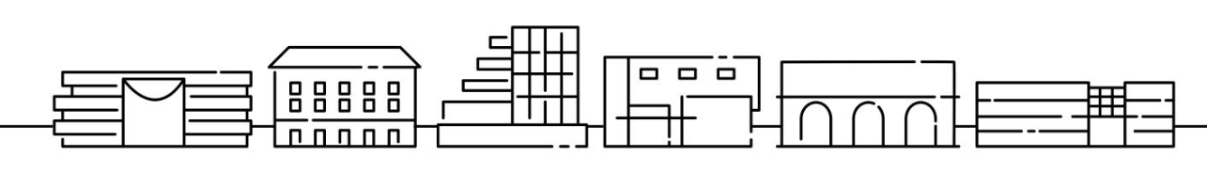
Odisee locations
Campus Terranova
Campus Brussel
Campus Dilbeek
Campus Aalst
Campus St-Niklaas
Techcampus Gent

Slide 13
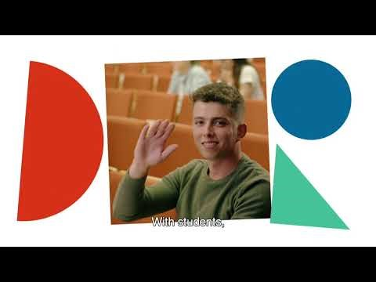

Slide 14
Professional Bachelor
Degree Programmes
Business Studies
Education
Business Management
B
A
Preschool Education
A
Office Management
B
A
Primary Education
A
SN
Applied Computer Science
B
Secondary Education
SN
Health Care
Industrial Sciences and Technology - Biotechnics
Bio-Medical Laboratory Technology
G
Preschool Education
B
Electromechanics
A
Occupational Therapy
B
Primary Education
B
Electronics-ICT
G
Medical Imaging
B
Secondary Education
B
Energy Technology
G
Optics and Optometry
B
School development
B
Design and Production Technology
G
Nutrition and Dietetics
G
Social and Community Work
Agro- and Biotechnology
SN
Nursing
A
SN
B
Midwifery
SN
Family Sciences
B
Construction
A
B
Intensive and Emergency Care
Psychosociol Gerontology
Chemistry
G
A
Facility Management
SN
G
Palliative Care
B
Socio-educational Care Work
B
Real Estate
A
Social Work
B

Slide 15

  Student Facilities
  Cultural and social activities
  Sports
  Workshops
  Student cafeteria
  Housing
  Study financing
  Reduction in theatres, cinema, concerts…
  Psychological and social counseling

Slide 16
Occupational Therapy at Odisee
4.

Slide 17
Odisee locations
Campus Terranova
Campus Brussel
Campus Dilbeek
Campus Aalst
Campus Brussel
TechCampus Gent
Occupational Therapy

Slide 18
Brussels as a context for learning skills
Brussels is the capital of Europe
After Dubai, there are no more nationalities living together anywhere in the world than in Brussels
Multi-cultural en multi-lingual
Different colleges and universities in Brussels, with a corresponding student life
In the center of Belgium, with good public transport to all major cities of the country and capitals as London, Paris, Amsterdam are only a few ours away by train.

Slide 19

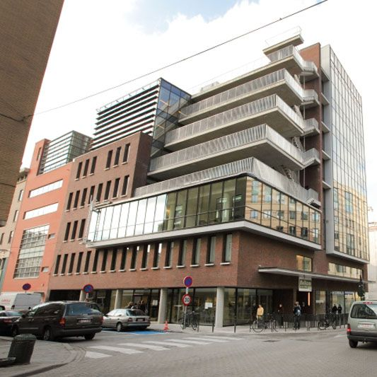




Campus Terranova: a synergetic concept
Brussels Health and educational centre
De Ketjes
Terranova
Vitanova
Sint-Jan

Slide 20
Learning flow GROWING
Professional development plan I | 3 | Professional development plan II and international project | 3 | Professional development plan III | 3
Work field experience I | 3 | Work field experience II and III | 5+5 | Work field experience IV, V and VI | 10+ 13+10
­­­­Health care organization | 3 |  |  | Interdisciplinary collaboration and management | 3
Learning flow THINKING
Professional reasoning IA and IB | 3+3 | Professional reasoning II | 4 | Professional reasoning III | 4
Evidence Based Practice I | 3 | Evidence Based Practice II | 4 | Bachelor thesis | 8
Learning flow ACTING
Occupational therapeutic skills I and II | 3+3 | Physical and geriatric rehabilitation I and II | 5+5 | Assessment and treatment | 3
Methodical skills | 4 | Mental Health I and II | 5+5 | Prevention and occupational cae | 3
 |  | Developmental dysfunctions I and II | 5+5 | Occupational therapy advice | 3
 |  |  |  | Entrepreneural skills | 3
­Learning flow KNOWING
Psychology | 4
Psycho pathology | 3
Psychomotor development | 3
Motion analysis I and II | 4+4
Anatomy and physiology I and II | 4+4 | Neuroscience | 4
Pathology I | 3 | Pathology II | 5 | Prepared for an internship outside of Europe | 3
Acting ethically and purposefully I | 3

Slide 22
What can we offer incoming students?
Traineeship
8 weeks Organized in spring/autumn (192 hours of practices + coaching and clinical reasoning + trainee report)
(12 credits)
Short bachelorproject
Organized in spring/autumn
(3 credits)
Digital Leadership and innovation
Organized in Spring
(3 credits)
Medical English organized in spring/autumn
(3 credits)
International Nursing Education Programme organized in spring
(3 credits)

Slide 23


Slide 24
More information
  Odisee
  www.odisee.be/en
  Discover Belgium
  www.belgium.be
  Discover Flanders
  www.flanders.be
  www.flanderstoday.eu
  Higher Education in Flanders
  www.studyinflanders.be
  www.highereducation.be/home
  Association KU Leuven
  associatie.kuleuven.be/eng

