Slide 1
Some activities in English
H. Le Roy

Slide 2
English for you is / means …
Keywords in PollEv

Slide 3
Learning English
Why do you need English?
What is difficult in English?
What can facilitate the learning of English?
> PollEv

Slide 4
Resources for learning
Spelling tools
Lexical tools
Contact with the language: press, radio, video
Annotate and retain
Translation
Keywords
Synthesis

Slide 5
Some activities
OT in English – Meertalige communicatie
https://hlrnet.com/sites/vt/ot-in-english-2/
What we’ll do
  Language exercises
  Terminology
  EBP Texts and contexts
  OT Texts and contexts

Slide 6
Some tools and references to carry on learning
News from the English-speaking world – News and sources for getting in touch with health care English
https://hlrnet.com/sites/actu-en/
with auto-activities
Meertalige communicatie
https://hlrnet.com/sites/vt/
online exercises with autocorrection
Your readings
Videos and online learnings (TEDx and other podcasts)

Slide 7
Please come back
Problemas de inglés para hispanohablantes – Alt164.info
https://hlrnet.com/sites/alt164/problemas-de-ingles-para-hispanohablantes/

Slide 8
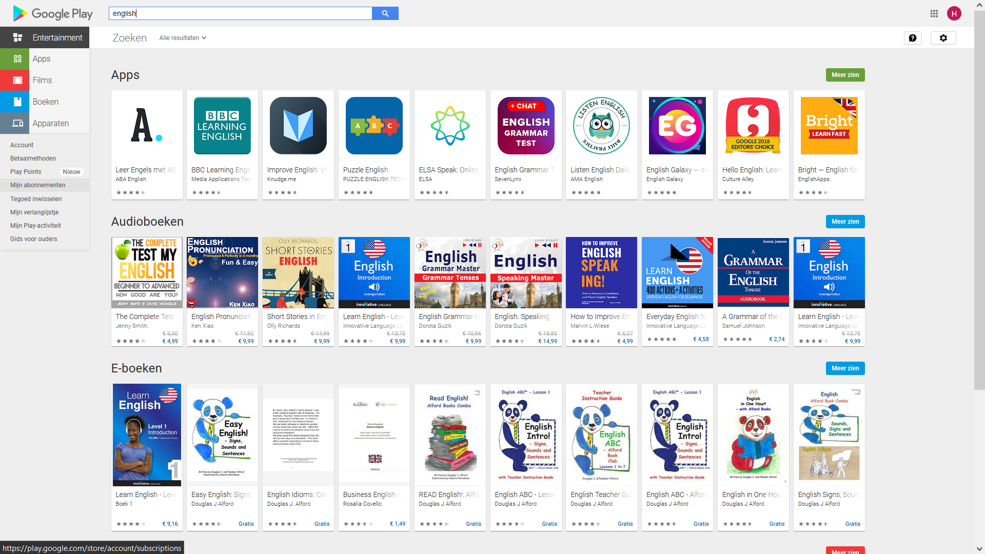
Google play: english

Slide 9
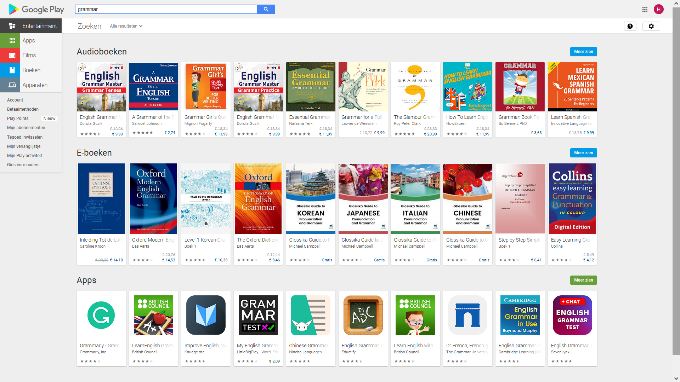
Google play: vocabulary

Slide 10
Google play: grammar

Slide 11
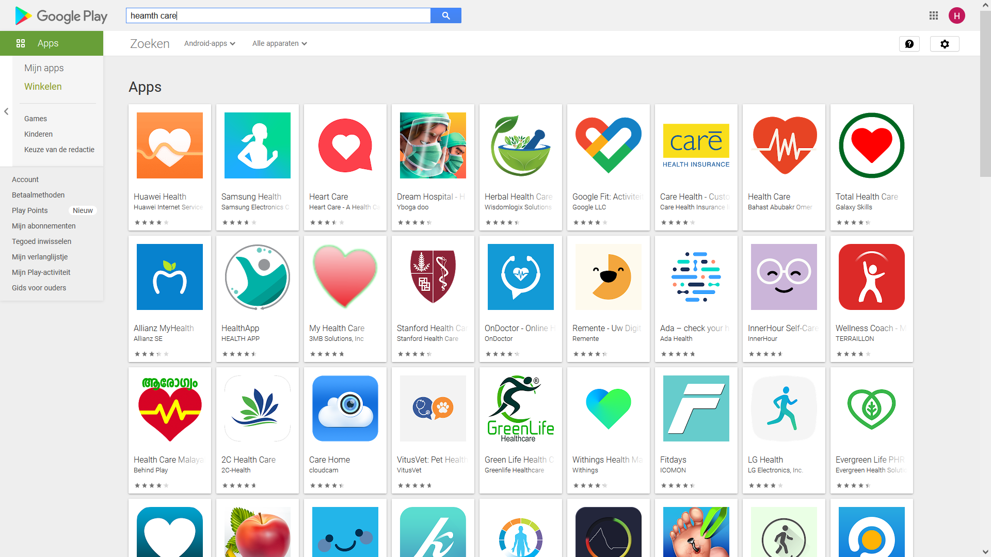
Google play: health care

Slide 12
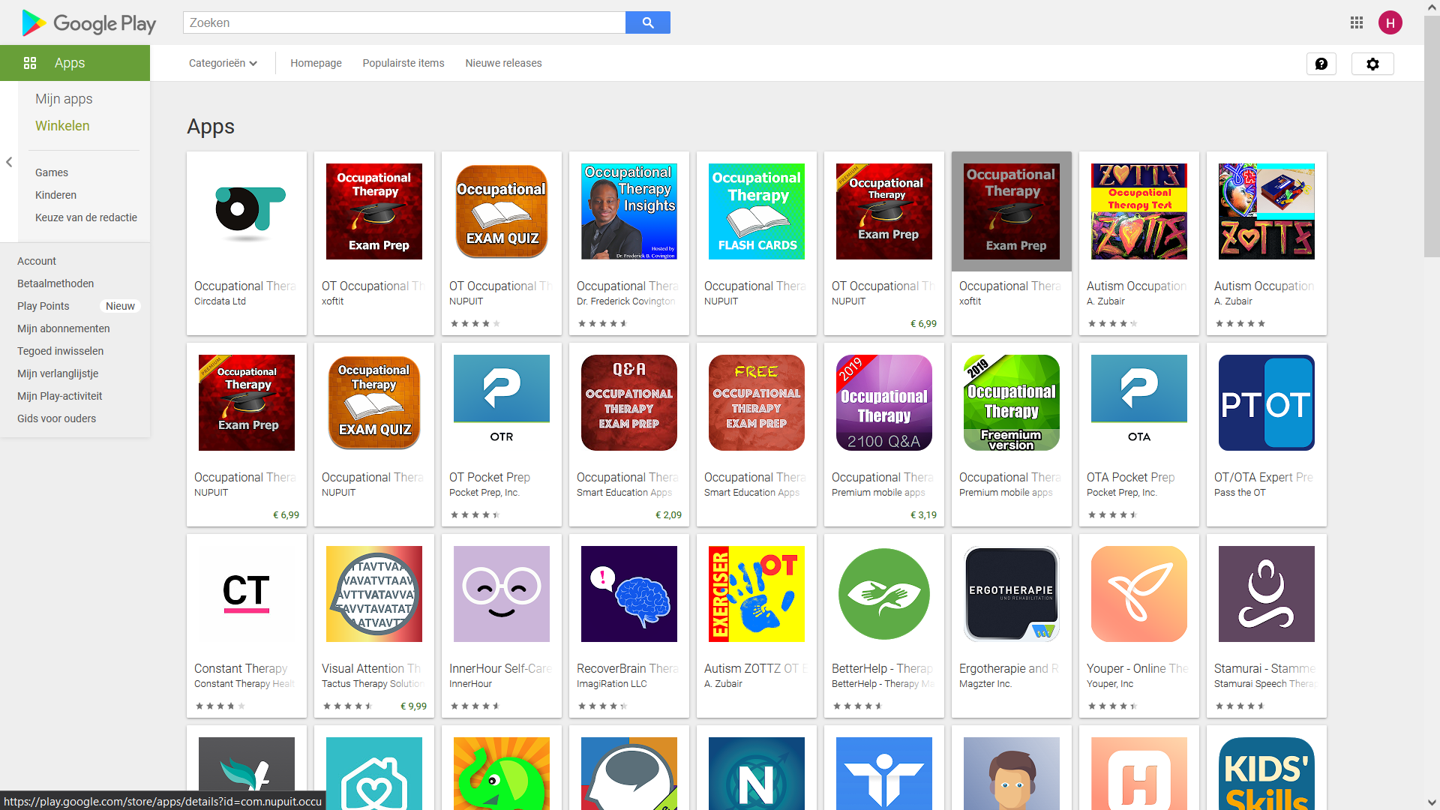
Google play: occupational care

